Slide 1
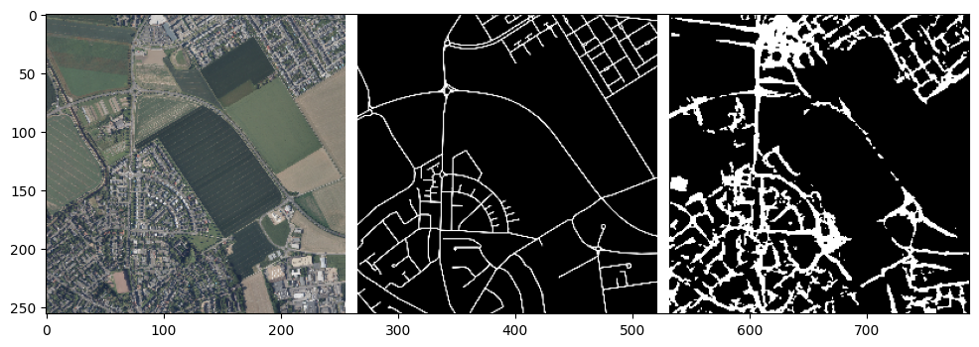
Automated Road Segmentation for Change Detection in Cologne
Adian Dawuda | s1093093

Slide 2
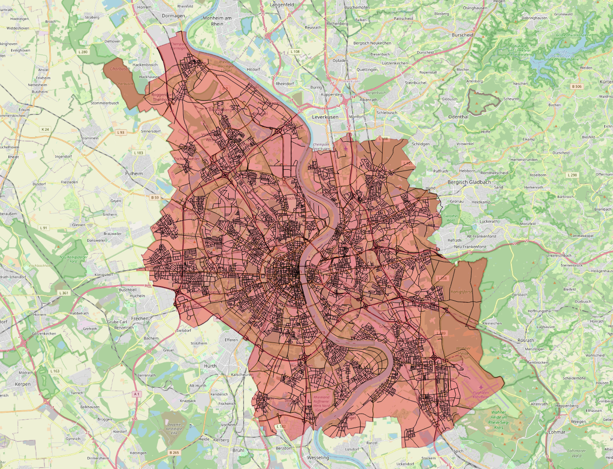
Introduction

Slide 3
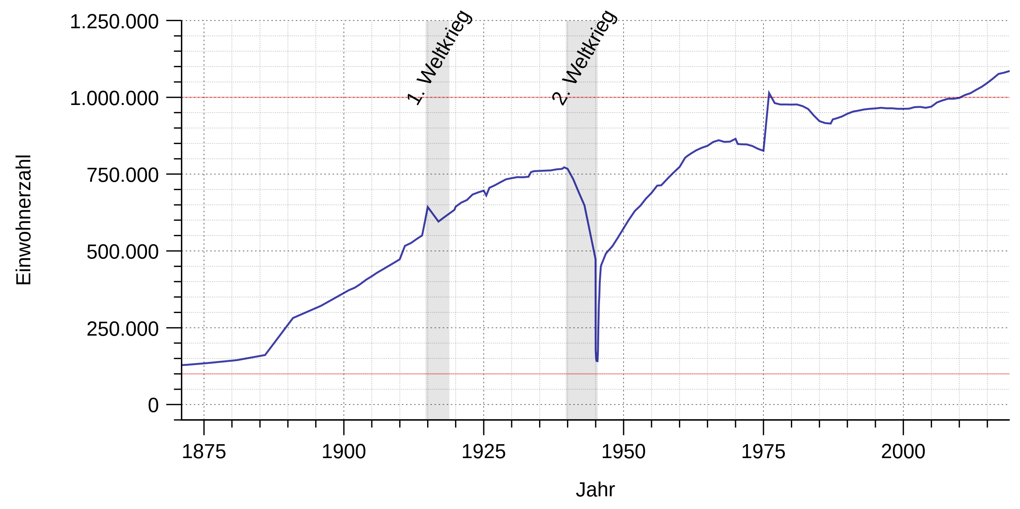
Introduction
Wikimedia: Summer ... hier! 2018

Slide 4
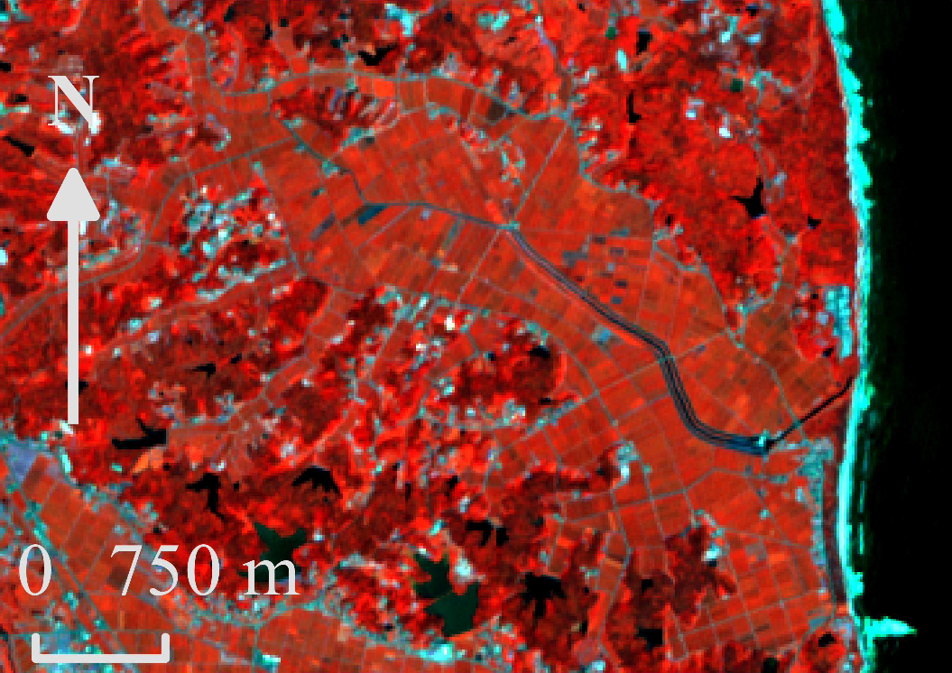
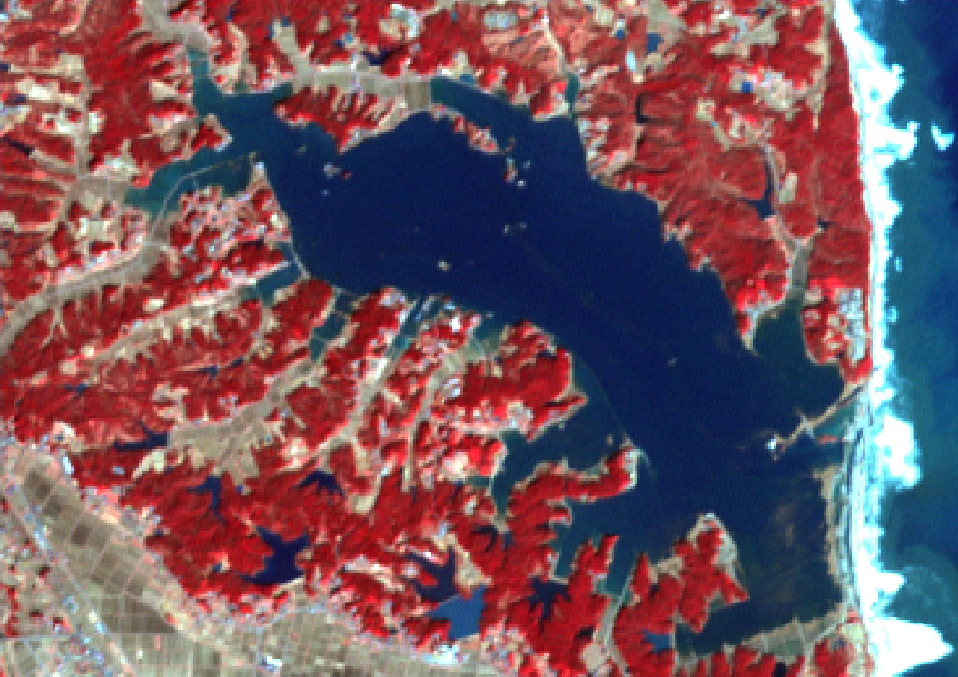
Introduction
Change Detection
Sublime & Kalinicheva 2019

Slide 5
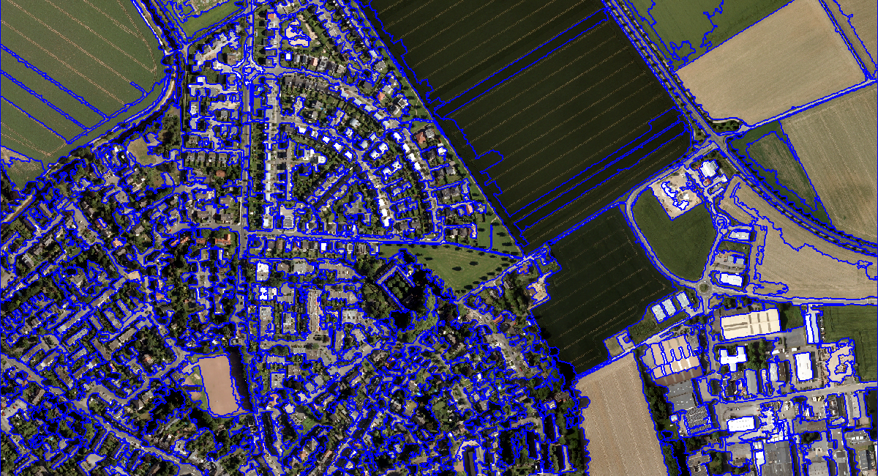
Introduction

Slide 6
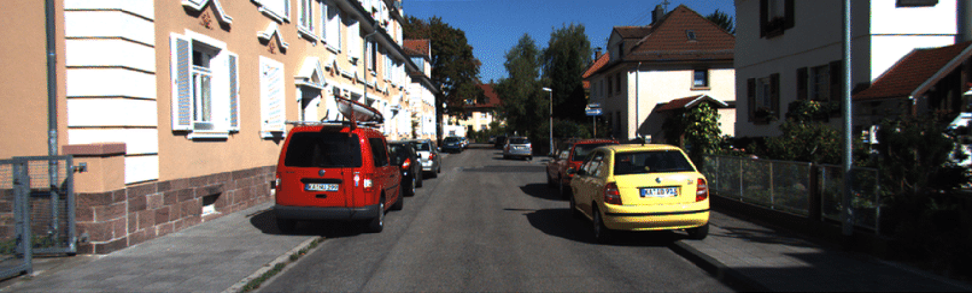
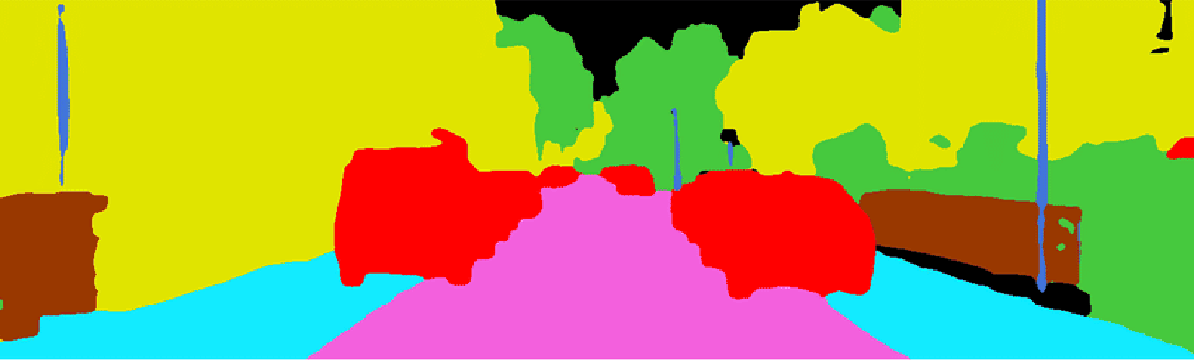
Introduction
Towards AI 2021

Slide 7
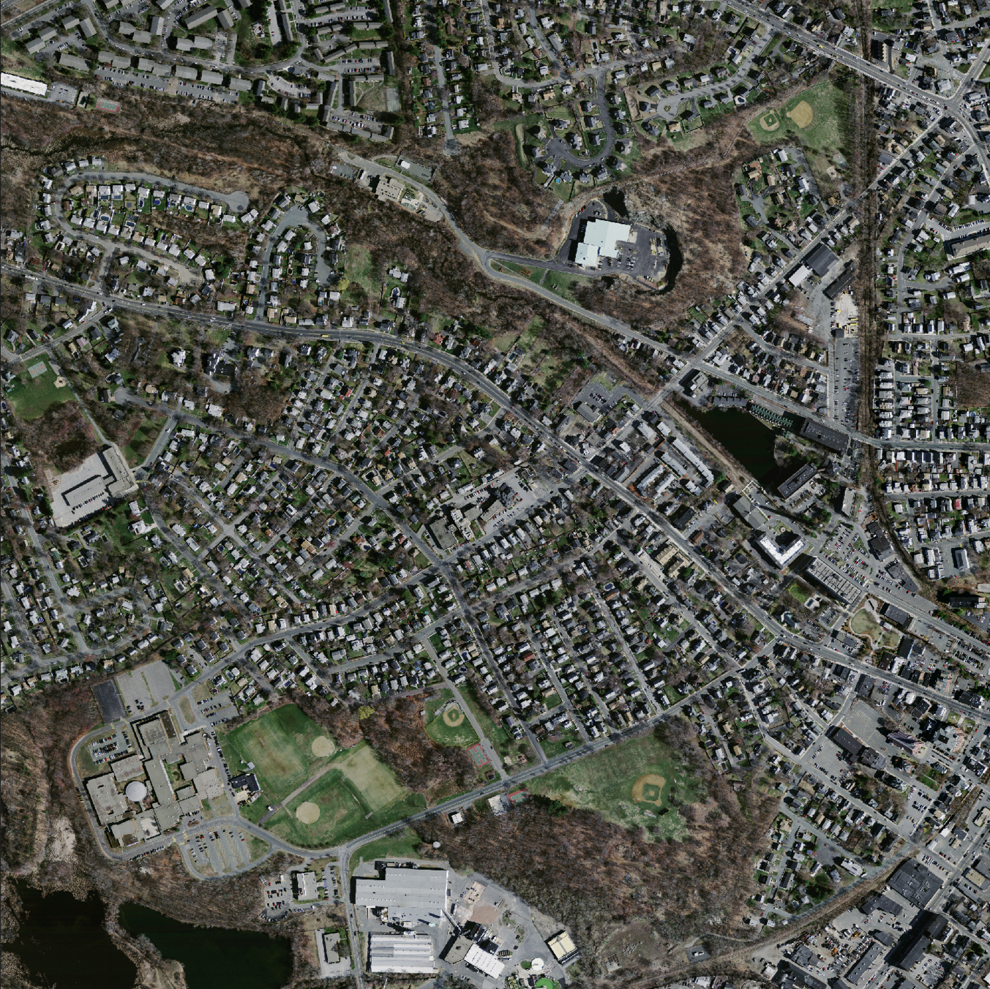
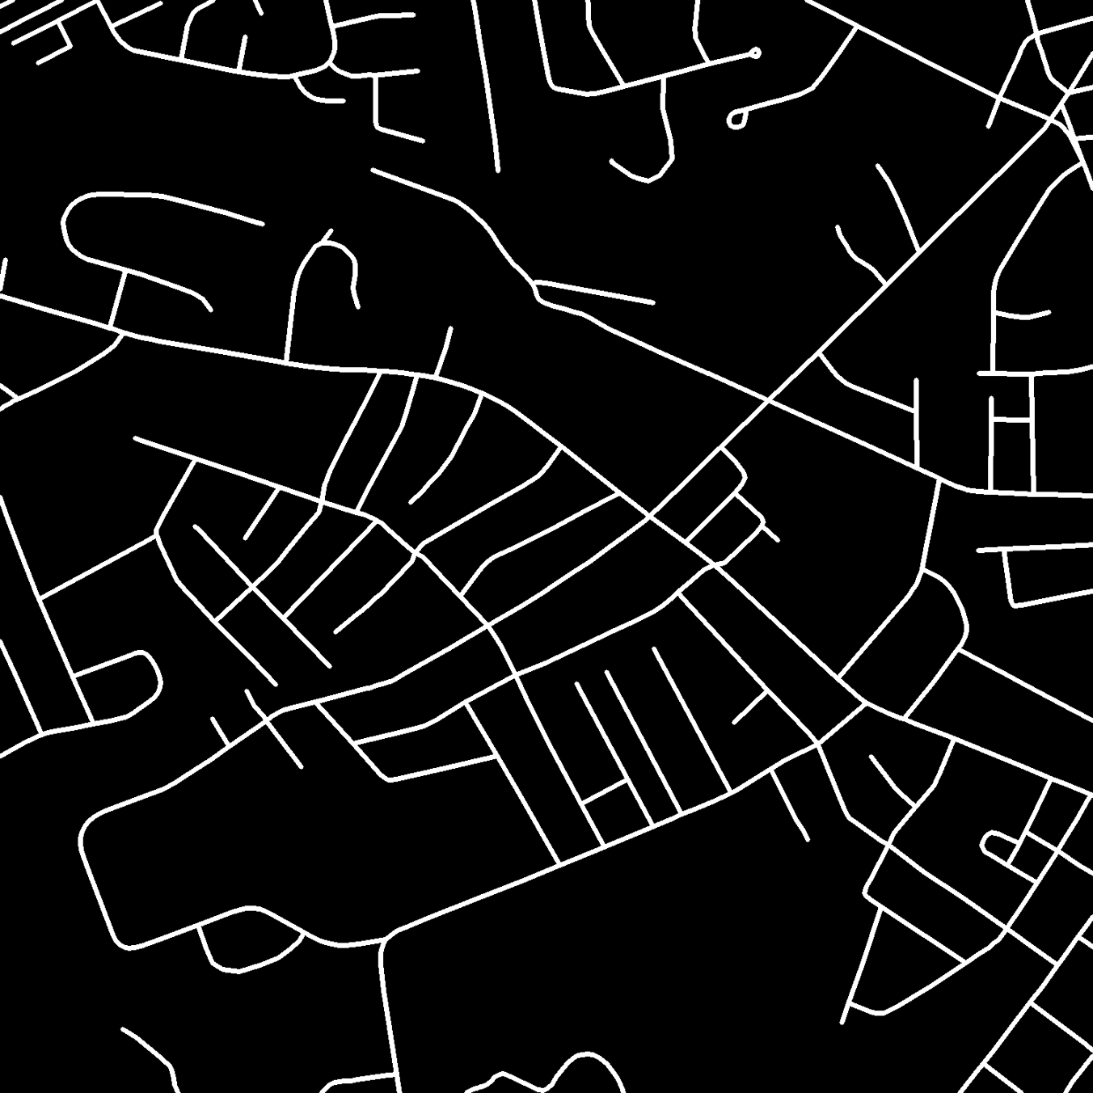
Data
Mnih 2013

Slide 8
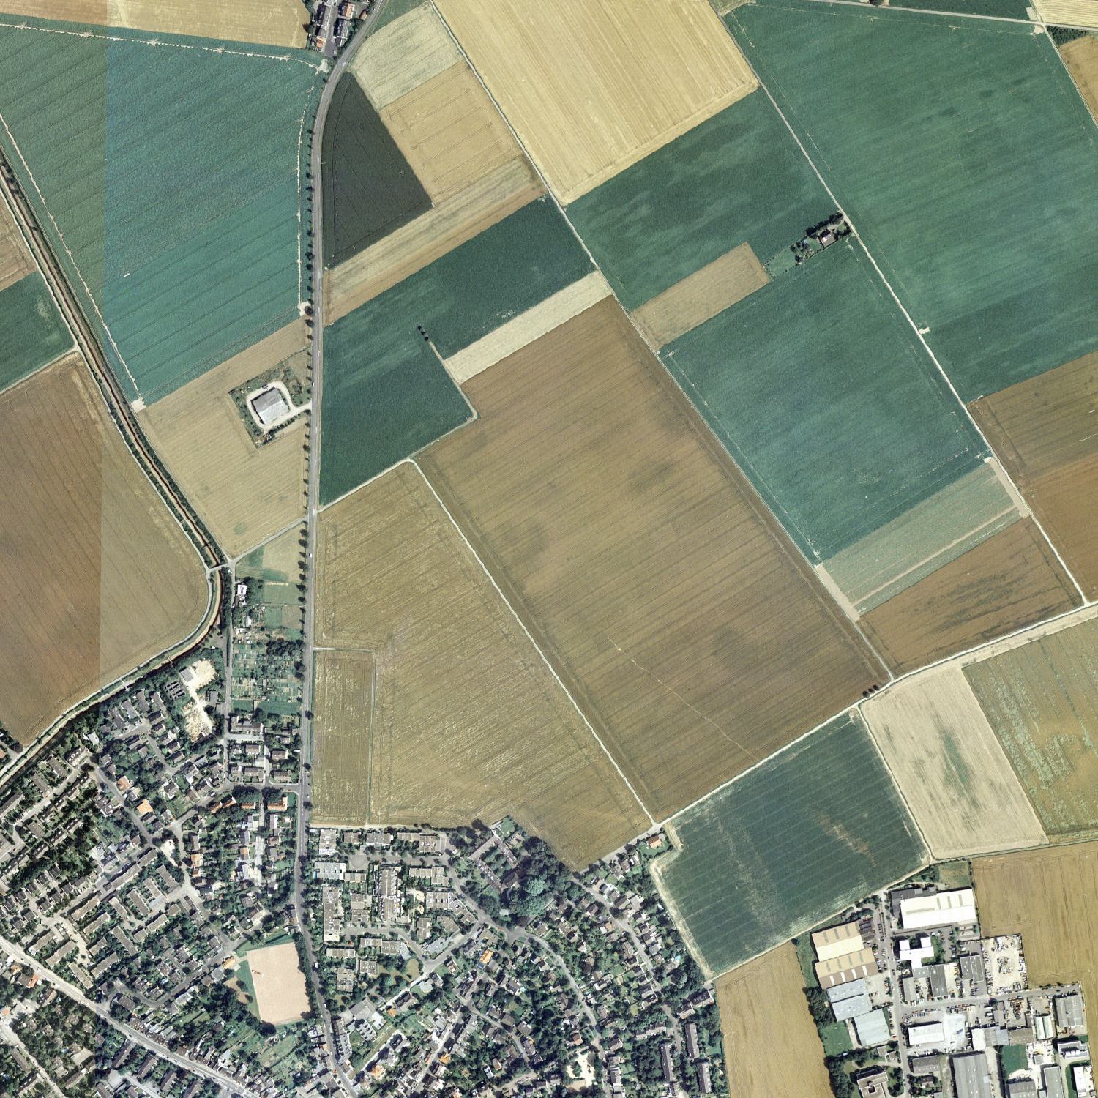
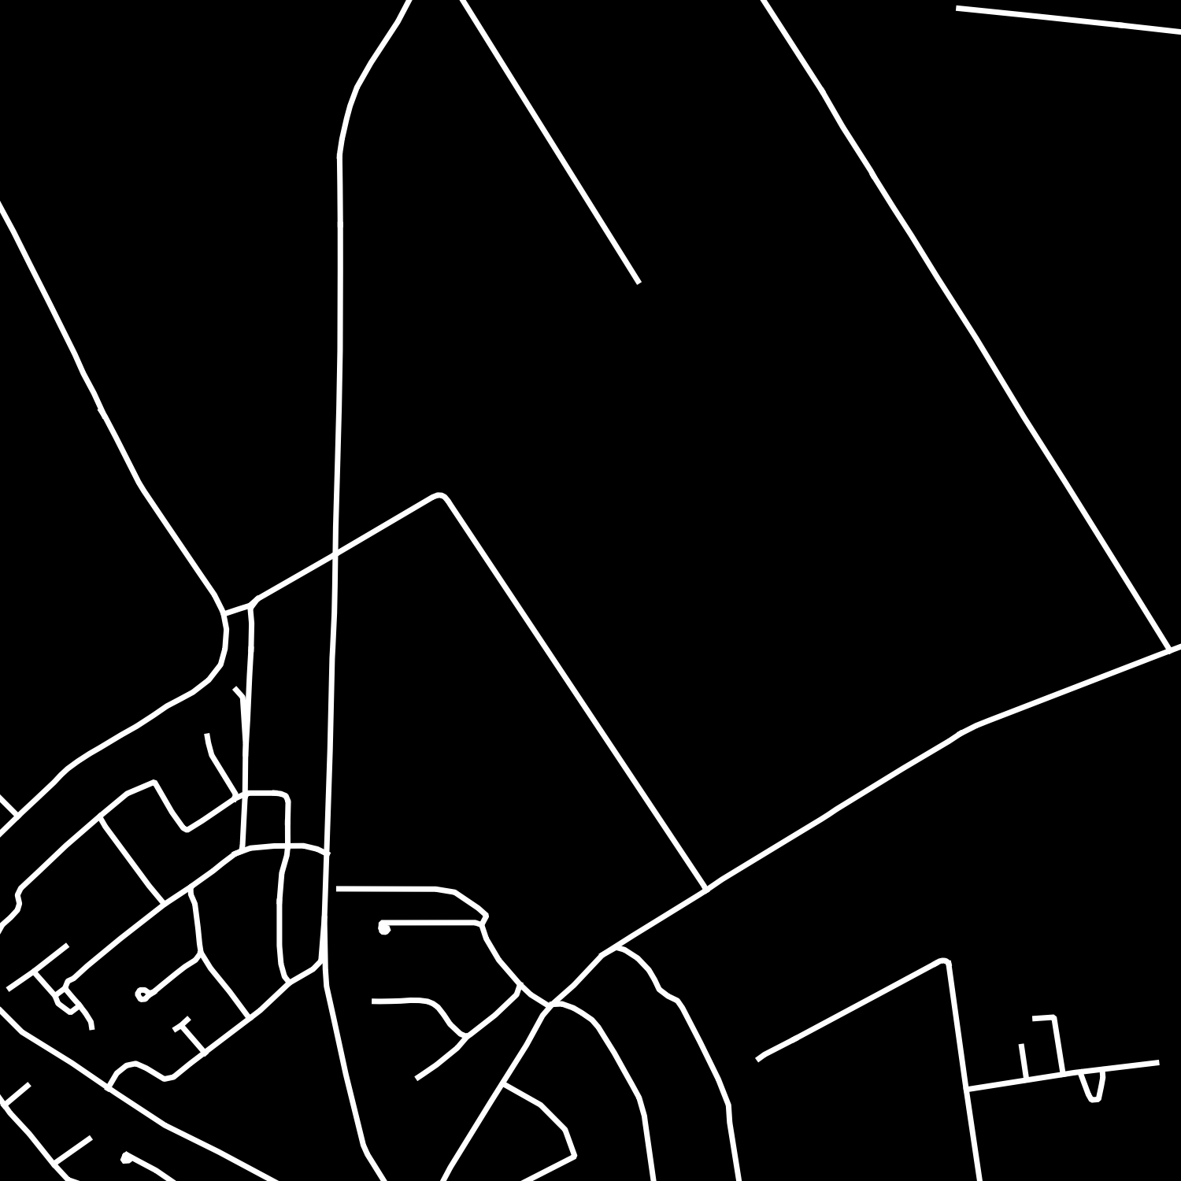
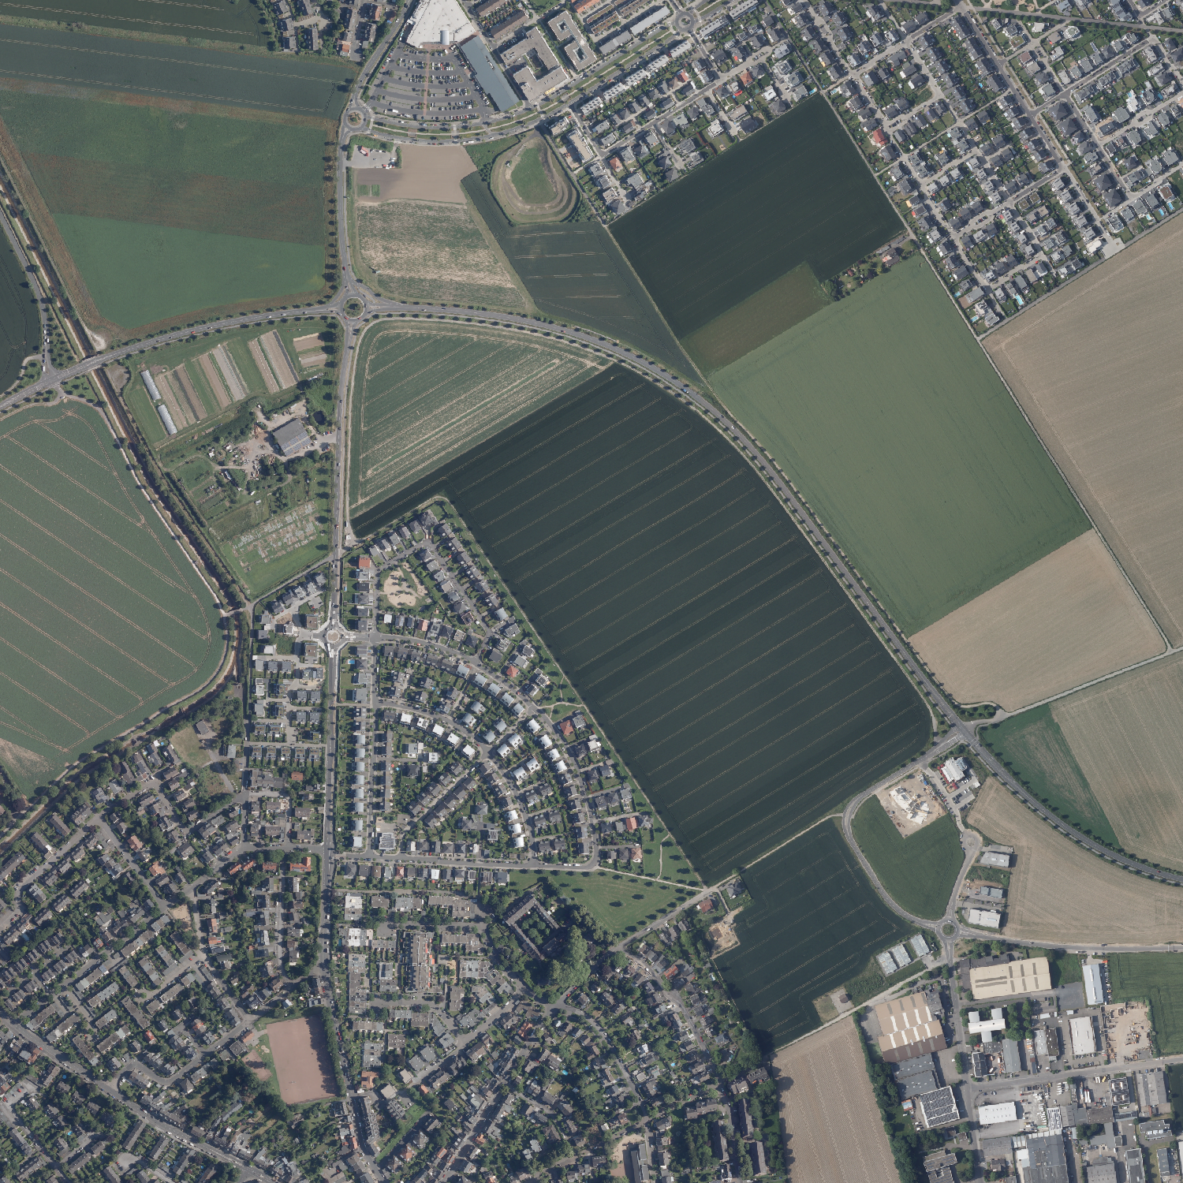
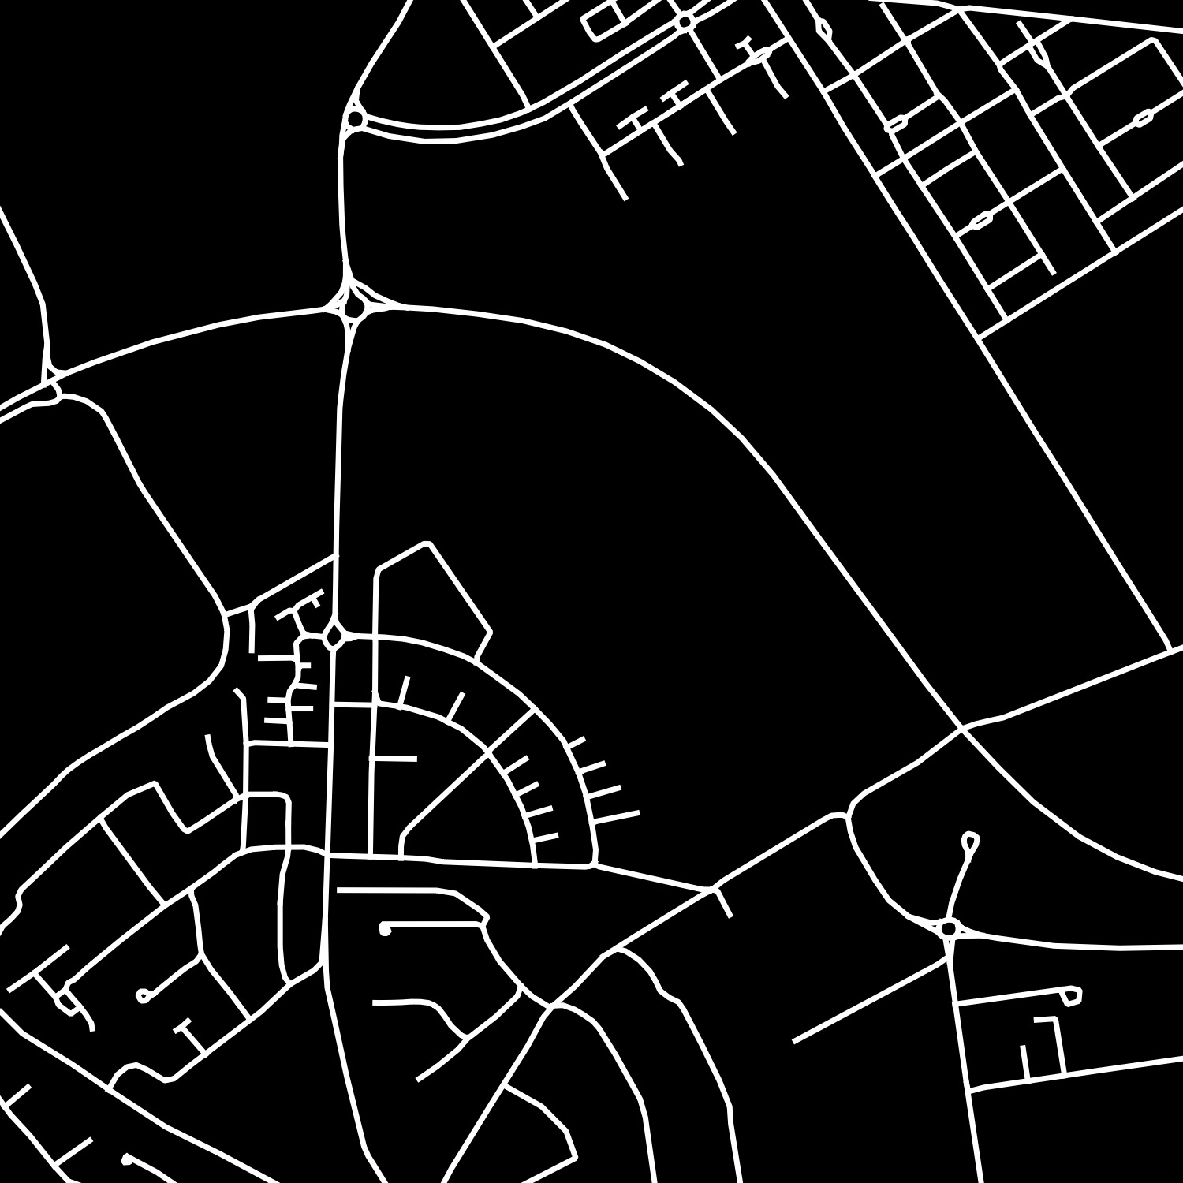
Data
1998
2019

Slide 9

Methods
Ronneberger et al. 2015

Slide 10



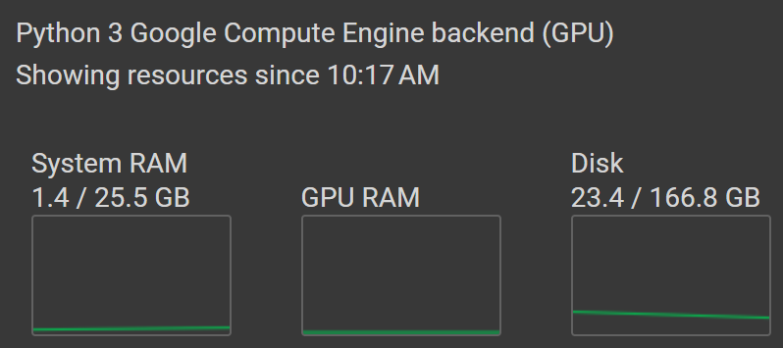
Methods
Implementation
Computing environment
Wikimedia: Tensorflow 2017, Wikimedia: python.org 2008, Wikimedia: Google 2021

Slide 11
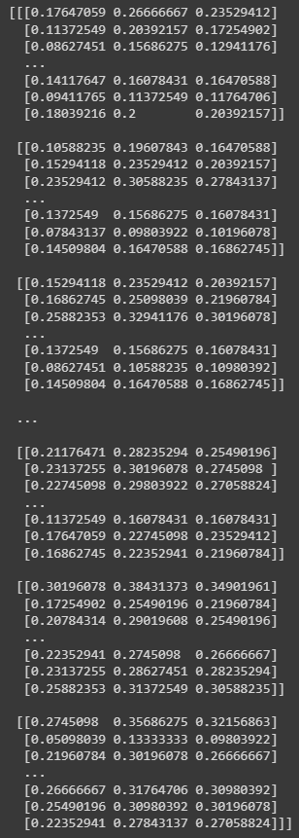
Methods

Slide 12
Methods
Hyperparameters
metric
learning rate
initialization
filter size
number of layers
filter stride
activation function
stopping condition
batch size

Slide 13
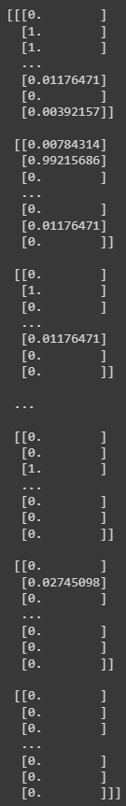
Methods

Slide 14
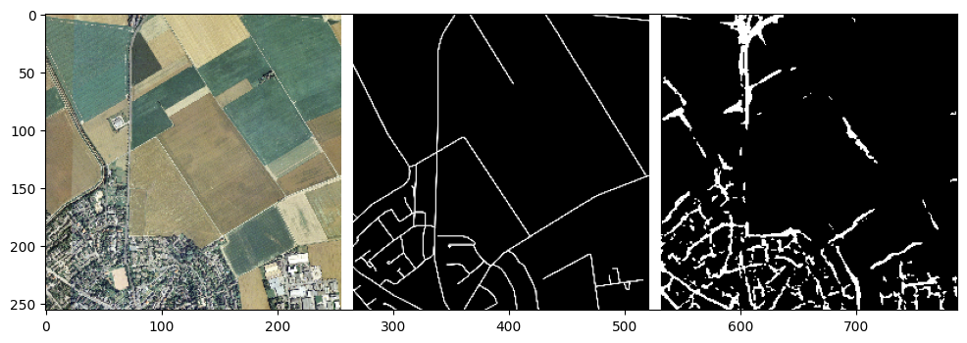
Methods

Slide 15
Results
1998

Slide 16
Results
2019

Slide 17
Discussion
Segmentation Accuracy
Time and Effort

Slide 18
Discussion
Cost
Accessibility
Transparency
Etc…

Slide 19
Discussion

Slide 20

Outlook
Unsplash: Nik 2017

Slide 21
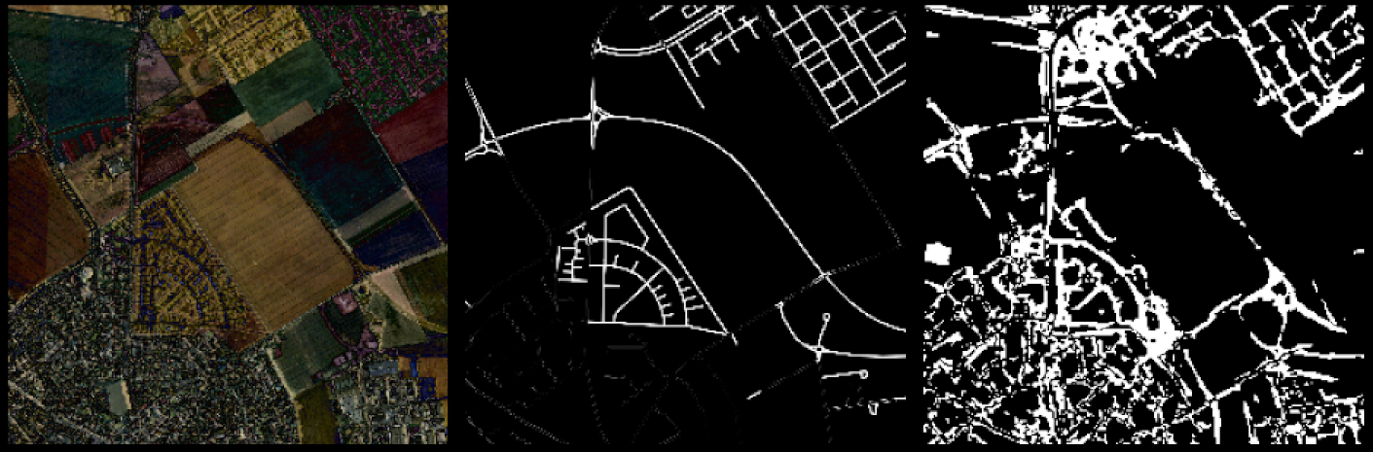
Overlayed difference

Slide 22
Literature
Gomes, V. C. F., Queiroz, G. R., & Ferreira, K. R. (2020). An overview of platforms for big earth observation data management and analysis. In Remote Sensing (Vol. 12, Issue 8). MDPI AG. https://doi.org/10.3390/RS12081253
Jakubovitz, D., Giryes, R., & Rodrigues, M. R. D. (2019). Generalization Error in Deep Learning. http://arxiv.org/abs/1808.01174
Kawaguchi, K., Bengio, Y., & Kaelbling, L. (2017). Generalization in Deep Learning. In Mathematical Aspects of Deep Learning (pp. 112–148). Cambridge University Press. https://doi.org/10.1017/9781009025096.003
Lang, S., Hay, G. J., Baraldi, A., Tiede, D., & Blaschke, T. (2019). GEOBIA achievements and spatial opportunities in the era of big earth observation data. In ISPRS International Journal of Geo-Information (Vol. 8, Issue 11). MDPI AG. https://doi.org/10.3390/ijgi8110474
Matsuyama, T. (1987). Knowledge-Based Aerial Image Understanding Systems and Expert Systems for Image Processing. IEEE Transactions on Geoscience and Remote Sensing, GE-25(3), 305–316. https://doi.org/10.1109/TGRS.1987.289802
Mnih, V. (2013). Machine Learning for Aerial Image Labeling.
Ronneberger, O., Fischer, P., & Brox, T. (2015). U-Net: Convolutional Networks for Biomedical Image Segmentation. http://arxiv.org/abs/1505.04597
Sudmanns, M., Tiede, D., Lang, S., Bergstedt, H., Trost, G., Augustin, H., Baraldi, A., & Blaschke, T. (2020). Big Earth data: disruptive changes in Earth observation data management and analysis? In International Journal of Digital Earth (Vol. 13, Issue 7, pp. 832–850). Taylor and Francis Ltd. https://doi.org/10.1080/17538947.2019.1585976
Wang, H., Wang, Y., Zhang, Q., Xiang, S., & Pan, C. (2017). Gated convolutional neural network for semantic segmentation in high-resolution images. Remote Sensing, 9(5). https://doi.org/10.3390/rs9050446
Wang, Z., Wang, E., & Zhu, Y. (2020). Image segmentation evaluation: a survey of methods. Artificial Intelligence Review, 53(8), 5637–5674. https://doi.org/10.1007/s10462-020-09830-9
Wu, H., Liu, Q., & Liu, X. (2019). A review on deep learning approaches to image classification and object segmentation. Computers, Materials and Continua, 60(2), 575–597. https://doi.org/10.32604/cmc.2019.03595
Yu, T., & Zhu, H. (2020). Hyper-Parameter Optimization: A Review of Algorithms and Applications. http://arxiv.org/abs/2003.05689

Slide 23
Images
Towards AI (2021). Semantic Segmentation: A Complete Guide. https://towardsai.net/p/l/machine-learning-7
Ronneberger, O., Fischer, P., & Brox, T. (2015). U-Net: Convolutional Networks for Biomedical Image Segmentation. http://arxiv.org/abs/1505.04597
Sublime, J., & Kalinicheva, E. (2019). Automatic post-disaster damage mapping using deep-learning techniques for change detection: Case study of the Tohoku tsunami. Remote Sensing, 11(9), 1123. https://www.mdpi.com/459996
Unsplash: Nik (2017). https://unsplash.com/photos/MAgPyHRO0AA
Wikimedia: python.org (2008). Python-logo-notext. https://commons.wikimedia.org/wiki/File:Python-logo-notext.svg
Wikimedia: Summer ... hier! (2018). Einwohnerentwicklung von Köln - ab 1871. https://commons.wikimedia.org/wiki/File:Einwohnerentwicklung_von_K%C3%B6ln_-_ab_1871.svg
Wikimedia: Tensorflow (2017). Tensorflow logo. https://commons.wikimedia.org/wiki/File:Tensorflow_logo.svg
Wikimedia: Google (2021). Google Colaboratory SVG Logo. https://commons.wikimedia.org/wiki/File:Google_Colaboratory_SVG_Logo.svg

